Slide 1
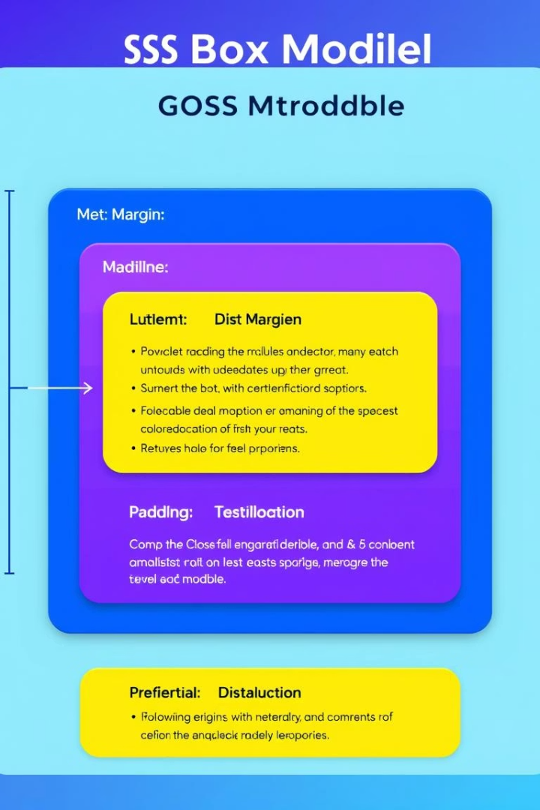
Day 2: Diving Deeper into CSS
Selectors, Box Model, and Layouts

Slide 2
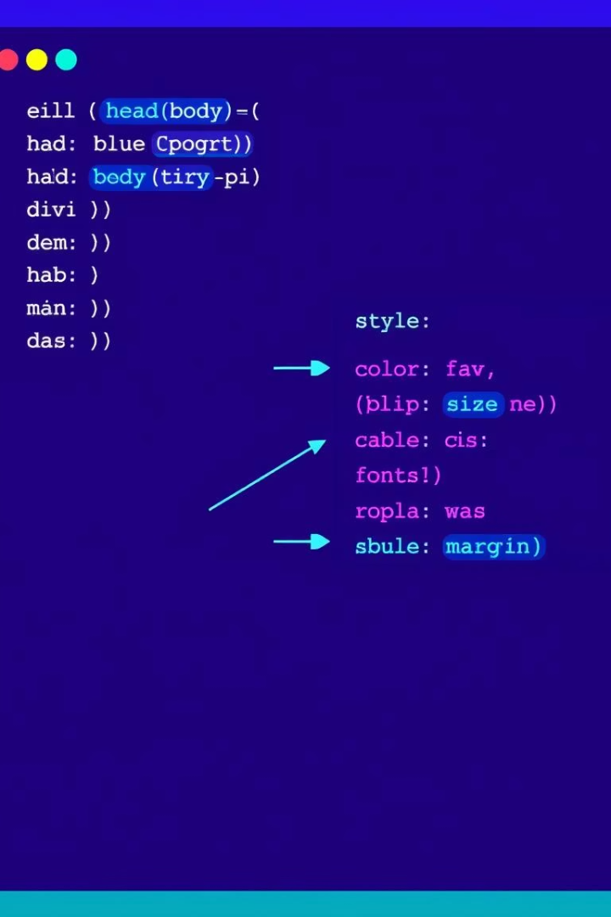
Day 1 Recap: CSS Basics
What is CSS?
Styling HTML to control page appearance
Basic Syntax
selector { property: value; }
CSS Types
Inline, Internal, External stylesheets
Quick Quiz
h1 { color: red; }

Slide 3
Advanced CSS Selectors
Class Selector
ID Selector
Reusable for multiple elements
Unique for one element
Example: .class-example { color: blue; }
Example: #id-example { color: green; }
Descendant Selector
Child Selector
Matches nested elements
Matches direct children only
Example: nav a { /* all anchors inside nav */ }
Finds ALL <a> tags anywhere inside a <nav>, no matter
how deep they're nested
Example: nav > a { /* direct children anchors */ }
Only styles <a> tags that are immediate children of <nav>
Pseudo-classes like a:hover add interactivity

Slide 4
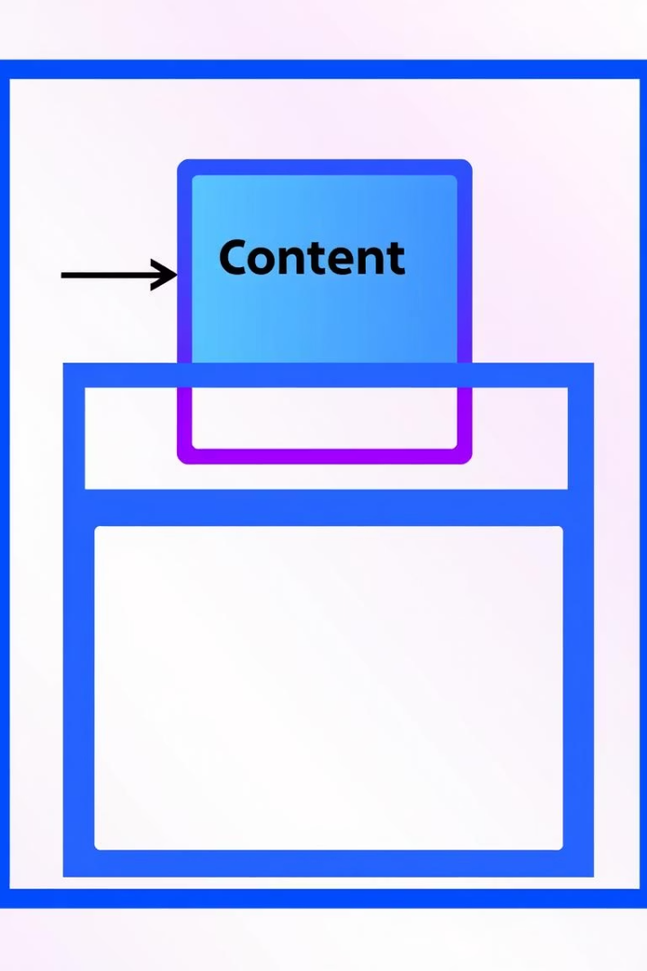
The CSS Box Model
Margin
Space outside border
Border
Visible edge around element
Padding
Space inside border
Content
Element's actual content area

Slide 5
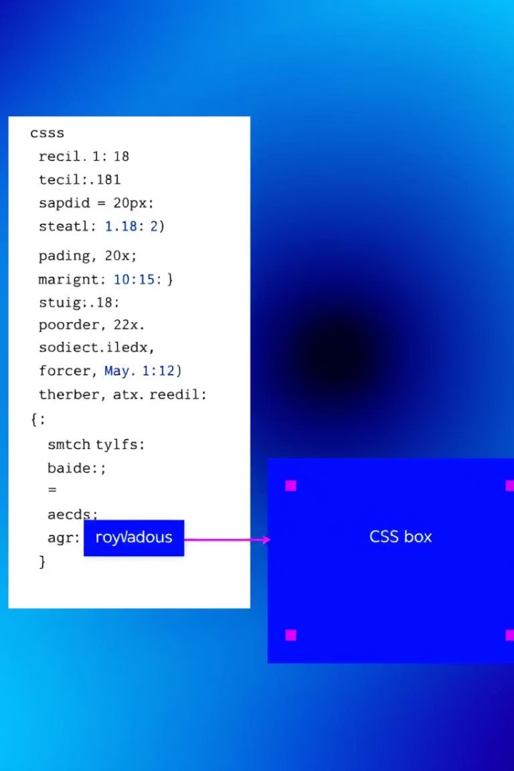
Box Model Hands-On
Example CSS
Try changing
.box { background: lightcoral; padding: 15px; margin: 10px; border: 3px dashed #333; }
padding and margin values; see layout changes
Visual feedback
Helps understand spacing and box structure

Slide 6
CSS Display Property
block
inline
inline-block
none
Full width, starts new line
Fits content, no line break
Inline flow, block features
Element hidden, no layout space
Flex
Children arrange in a row by default
Easy control of spacing
and alignment

Slide 7
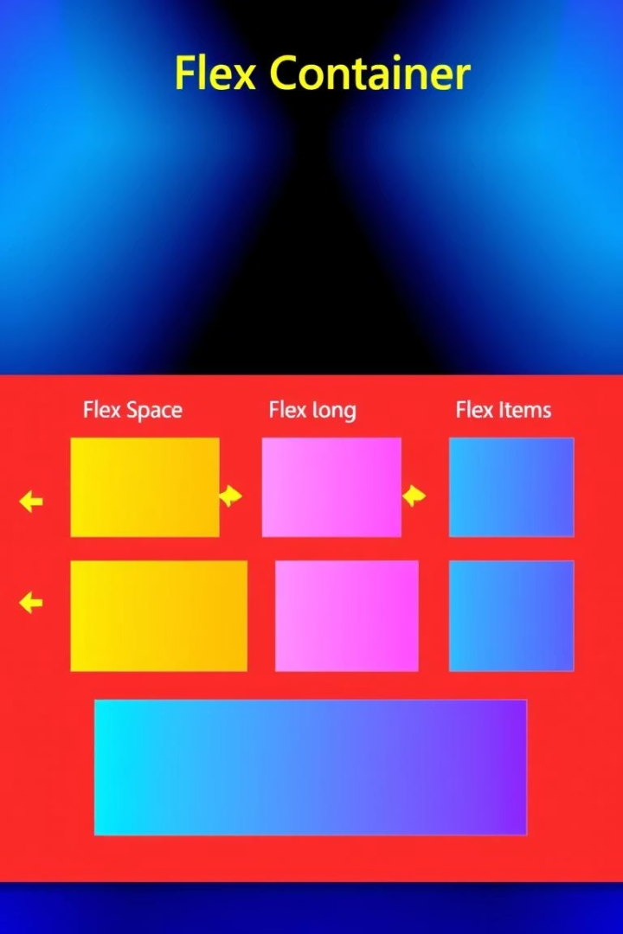
Flexbox Basics
Display Flex
Sets container as flexbox
Flex Direction
Row or column layout
Justify Content
Horizontal alignment of items
Align Items
Vertical alignment inside container

Slide 8
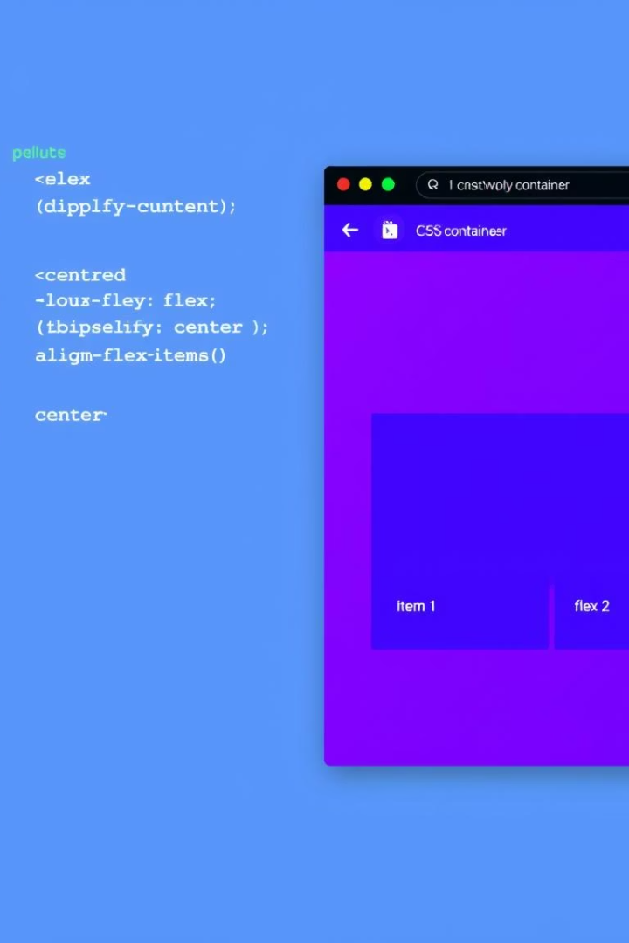
Flexbox Code Demo
.container { display: flex; flex-direction: row; justify-content: center; align-items: center; }
.item { flex: 1; padding: 10px; border: 1px solid #ccc; }
Adjust properties to change item layout and spacing

Slide 9
CSS Layouts Overview
Block Layout
Flexbox
Grid
Stacked vertically, simple flow
Arrange items in row or column
Two-dimensional layout control

Slide 10

Key Takeaways & Next Steps
Select with precision
Use advanced selectors for targeting
Master box model
Understand layout spacing and borders
Use display wisely
Control element layout and visibility
Flexbox for flexible design
Improve responsiveness and alignment
Practice with exercises and explore CSS Grid next

